Slide 1
WP3: Urban pluvial flood modelling and prediction
Kick-off Meeting
Ecole des Ponts Paris Tech
November 17th 2011
Prof. Čedo Maksimović
ICL Team: Li-Pen Wang, Susana Ochoa, Nuno Simões, Christian Onof, Neil McIntyre

Slide 2
INTRODUCTION TO URBAN PLUVIAL
FLOOD MODELLING AND FORECASTING
What is urban pluvial flooding?
How to model urban pluvial flooding?
Requirements of urban pluvial flood models

Slide 3
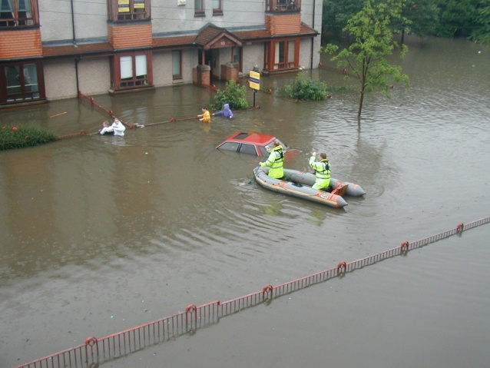
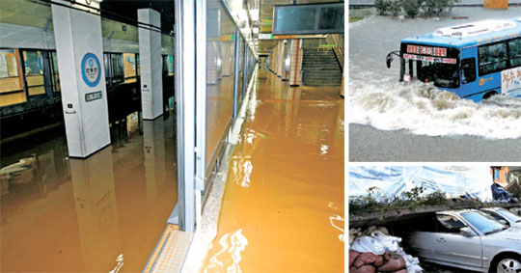
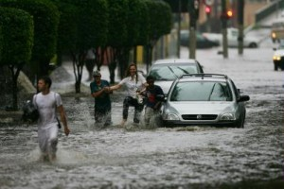
WP3 - Introduction
Urban Pluvial Flooding
Extreme rainfall events exceed the capacity of the drainage system!

Slide 4
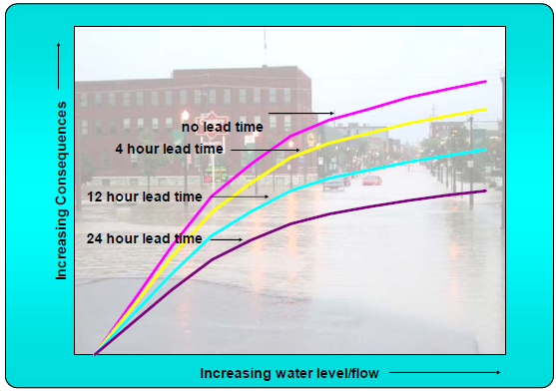
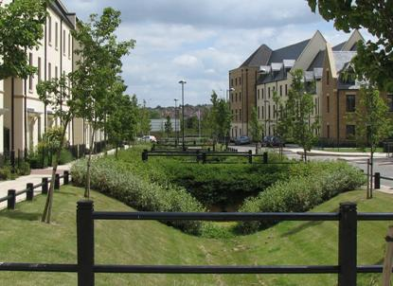
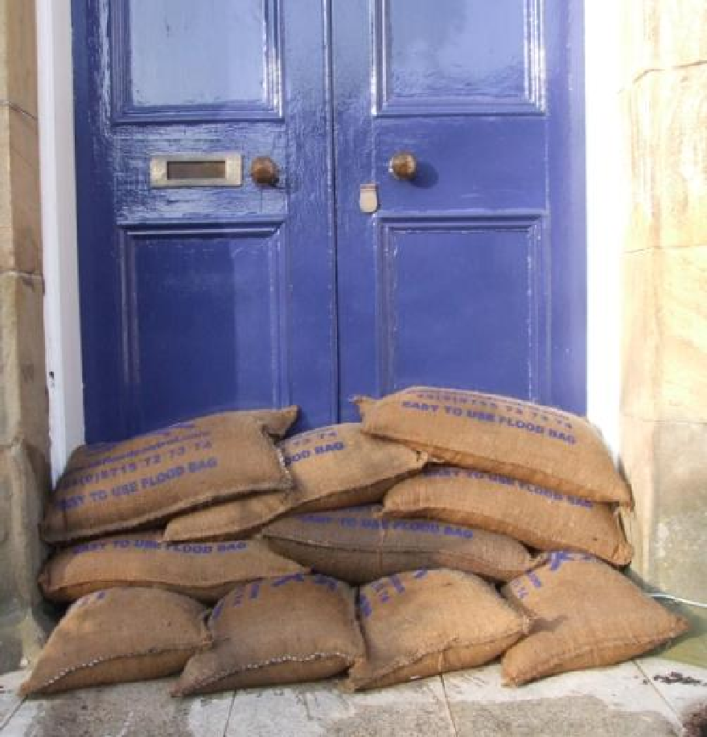
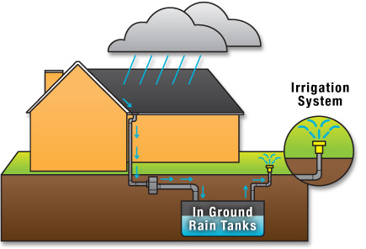



WP3 - Introduction
Urban Pluvial Flooding
Mitigation solutions?
Improved Forecasting and Event Management
Advanced (Water Sensitive) Urban Planning

Slide 5
Model Assembly for Pluvial Flood Modelling, Forecasting and Management
WP3 - Introduction
Observations
Rainfall Estimation / Forecasting
Urban Planning / Emergency management
Flood Modelling / Forecasting (WP3)

Slide 6
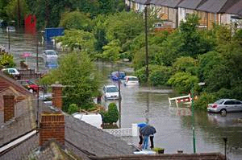
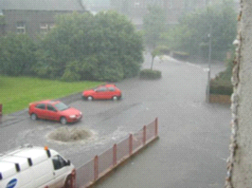
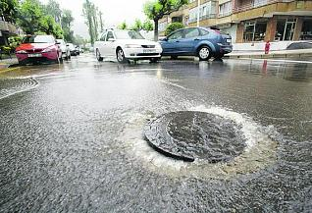
Modelling of Urban Pluvial Flooding –
Dual Drainage Concept
WP3 - Introduction

Slide 7
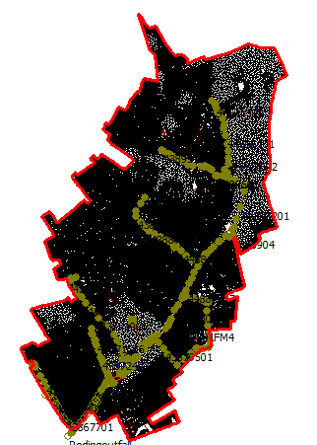
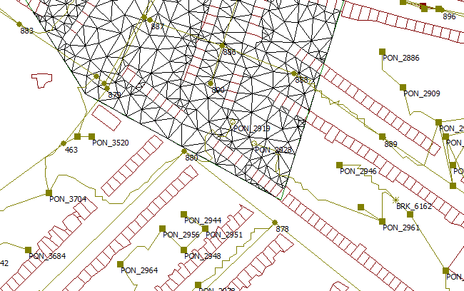
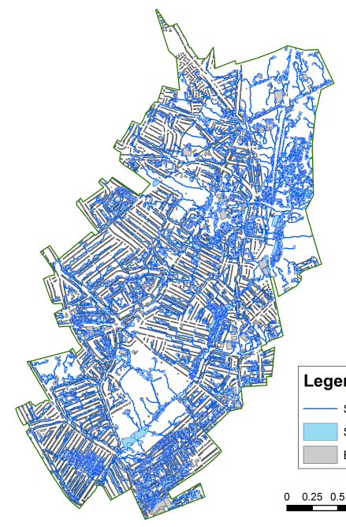
To combine their advantages and overcome their disadvantages…
WP3 - Introduction
1D / 2D
Hybrid
1D/1D + 1D/2D simulation
1D / 1D
Notes:
Untie a knot

Slide 8
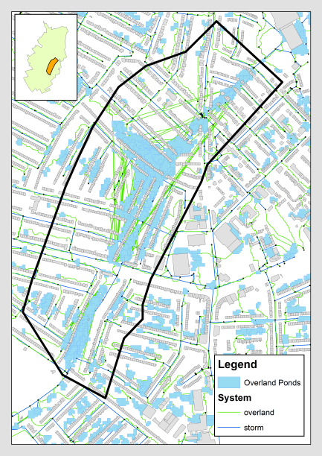
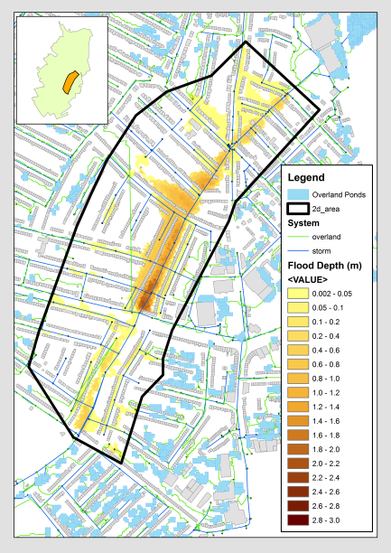
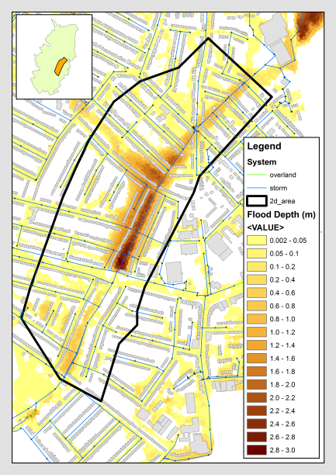
Do hybrid models perform well?
WP3 - Introduction
1D1D
Hybrid
1D2D

Slide 9
2. Objectives and Actions of WP3

Slide 10
WP3 “Connections”
WP3 – Objectives & Actions
The main input for flood modelling and forecasting is rainfall (WP2): the main inputs will come from WP2
The results of WP3 are the basis for flood risk management and enhanced urban water management strategies (WP4): it constitutes one of the main inputs for WP4
WP2
WP3
WP4

Slide 11
WP 3 - Actions
WP3 – Objectives & Actions
A10: Adoption, customisation and automatic linkage of rainfall forecasts to pluvial flood models
A11: Improvement and customisation of models for urban pluvial flood forecasting at fine scales in each of the pilot locations.
A12: Full-scale testing of the models for pluvial flood prediction in each of the pilot locations
A13: Development of guidelines and training material for capacity building and training of future end-users

Slide 12
4. Case Studies

Slide 13
WP3 – Case Studies
CASE STUDY | RAINFALL DATA AVAILABLE | HYDRAULIC MODELS
Rotterdam (NL) | new polarimetric X-band radar | Sobek-Urban
Paris (FR) | new polarimetric X-band radar | ?
Leuven (BE) | enhanced previously acquired X-band radar and acquisition of 4 additional rain gauges | Infoworks
Croydon (UK) | upgraded C-band radar, testing and implementation of superresolution protocol | Tuflow
Redbridge (UK) | upgraded C-band radar, testing and implementation of superresolution protocol | Infoworks
Other rainfall data sources? Are the hydraulic models set up? Do they have a surface component?

Slide 14
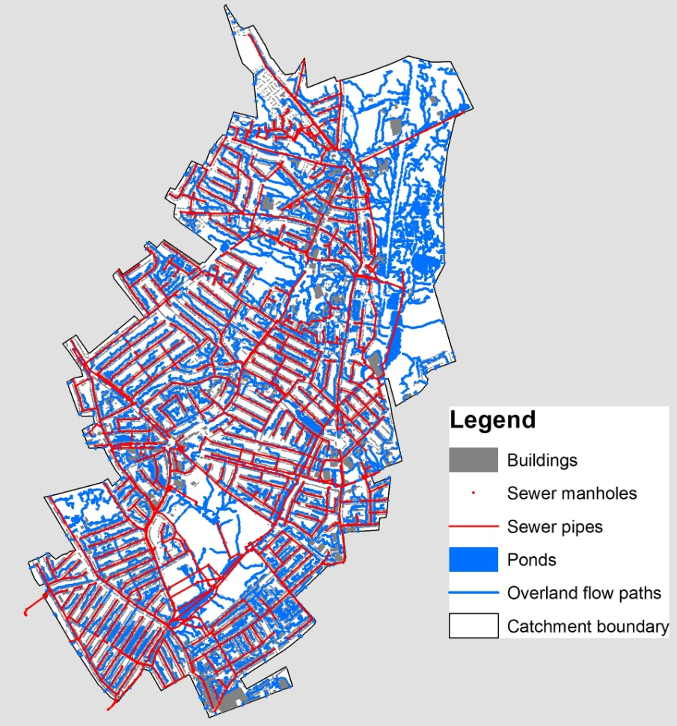
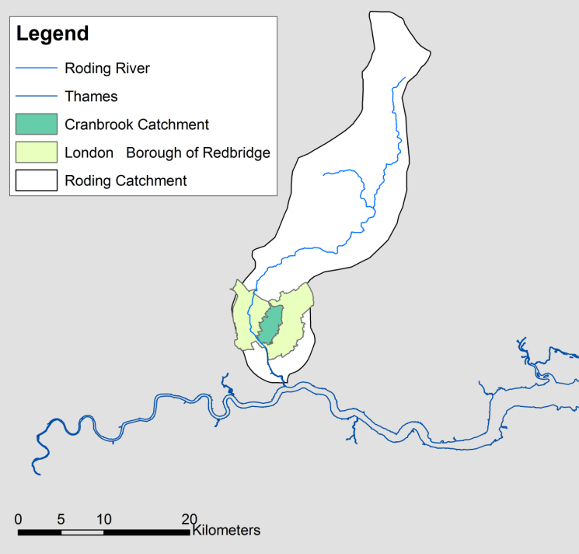
UK Study Site: Cranbrook catchment
WP3 – Case Studies
The drainage area of the Cranbrook catchment is approximately 910 hectares; the main water course is about 5.75 km long, of which 5.69 km are piped or culverted.

Slide 15
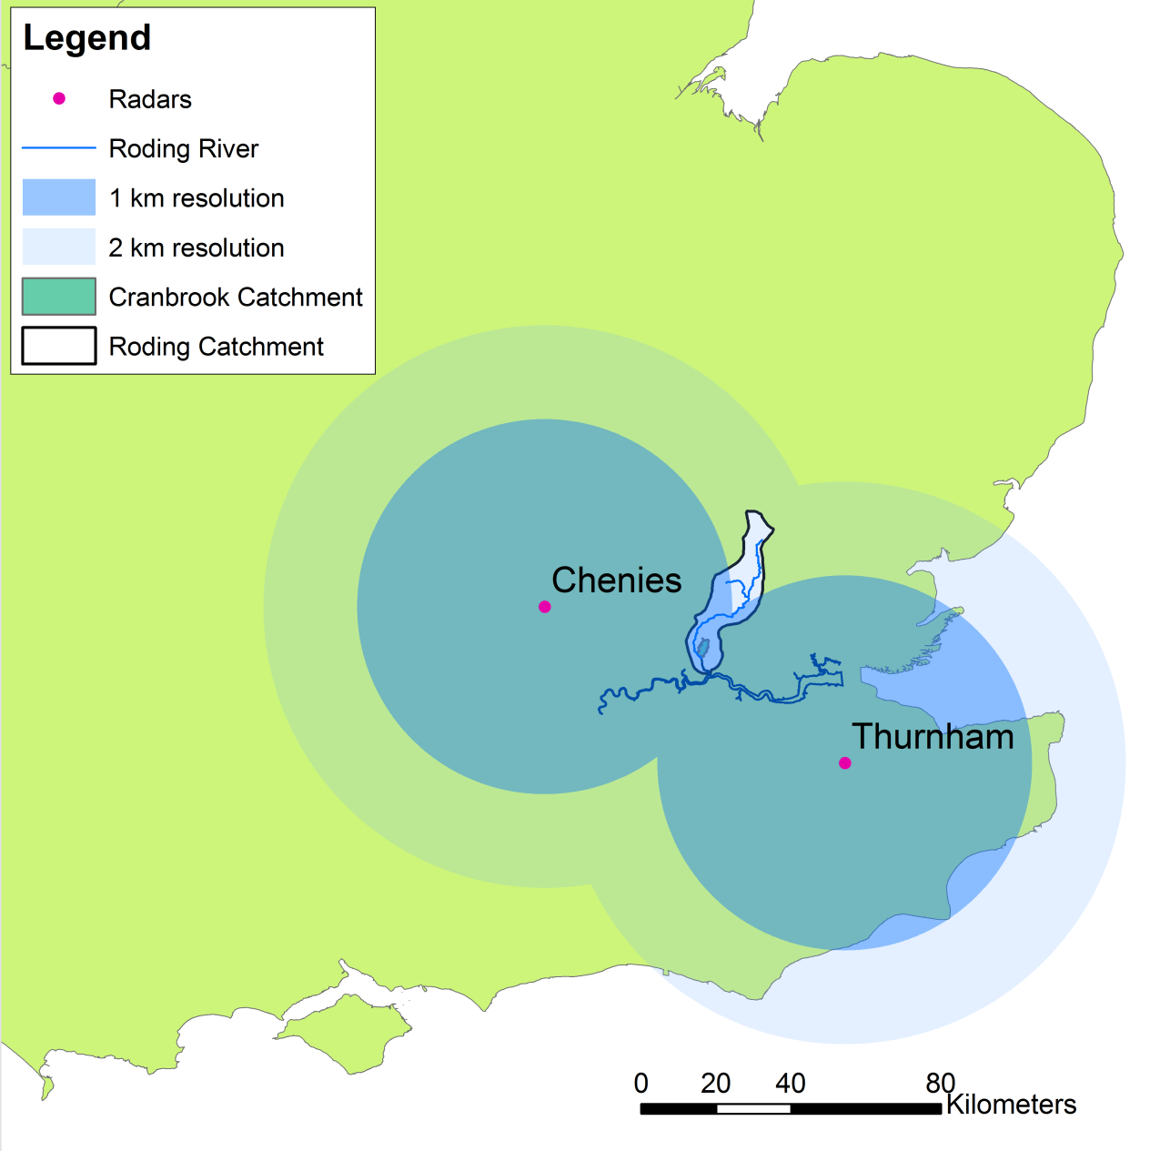
The Cranbrook catchment is within the coverage area of two C-band radars: Chenies and Thurnham, operated by UK Met Office
WP3 – Case Studies

Slide 16
5. Contact details
Prof. Čedo Maksimović
Department of Civil and Environmetal Engineering
Imperial College London
c.maksimovic@imperial.ac.uk
Prone + 44 20 7594 6013

